Slide 1
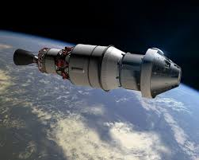
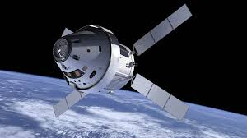
Orion spacecraft

Slide 2
Contents:
1. Introduction
2.shape & capacity
3.development history
4.spacecraft design
5.first test flight and beyond.
6.major purpose

Slide 3
Introduction
Firstly, spacecraft is a vehicle that carries humans beyond earth, into space.
The Orion multi-purpose crew vehicle is NASA’s planned spacecraft to take astronauts onto mars.
The agency launched the first test flight of spacecraft in December 2014,with crewed missions possibly following in the early 2020’s.

Slide 4
Shape & capacity
Similar in shape to Apollo spacecraft, Orion is supposed to carry up to six astronauts to destinations such as a captured asteroid or within reach of mars.
But this will be an upgrade to Apollo, with the newer, and much larger, spacecraft using electronics decades more advanced than what astronauts used to fly to the moon.

Slide 5
Development history
LOCKHEED MARTIN is the prime contractor for the spacecraft.
Lockheed martin space systems co. is an American aerospace company.
The company began work on the spacecraft in 2004 during a competition for the contract , which was valued at up to $8.15 billion upon award in august 2006.
Orion, however , was originally built for NASA’s constellation program that was intended to bring humans to the moon and to Mars. That program was cancelled in 2010 after President Barack Obama said that NASA should adopt a more “flexible destination” approach to space exploration.

Slide 6
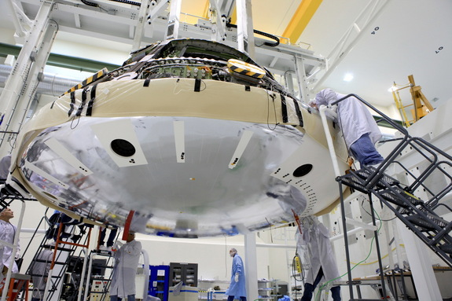
NASA had already spent $5 billion on developing Orion at that point, and Lockheed had been working on the spacecraft for about six years(including the competition). In early 2011, however , NASA hinted that the Orion spacecraft could be “repurposed”. The agency followed that up in may with a plan for the multi-purpose crew vehicle –one that was reasonably close to the Orion spacecraft design, but could still be used for the new mandate.

Slide 7
Spacecraft design
Orion can hold between two and six astronauts and is designed to launch on NASA’s next generation space launch system rocket ,which is supposed to have its first test flight in 2017 or 2018.
The gumdrop-shaped capsule and the service module together are about 26 feet (8 meters) long with a diameter of 16.5 feet(5 m).The spacecraft’s habitable volume is just 316 cubic feet(8.95 cubic meters), which is about 1.5 times larger than the Apollo spacecraft.
The service module, built by European space agency, contains solar panels for electricity, oxygen for breathing and rocket engines to propel the spacecraft .Orion also includes a spacecraft adapter(which shields the service module during launch)and an instrument unit that includes the guidance and control system for the booster.

Slide 8
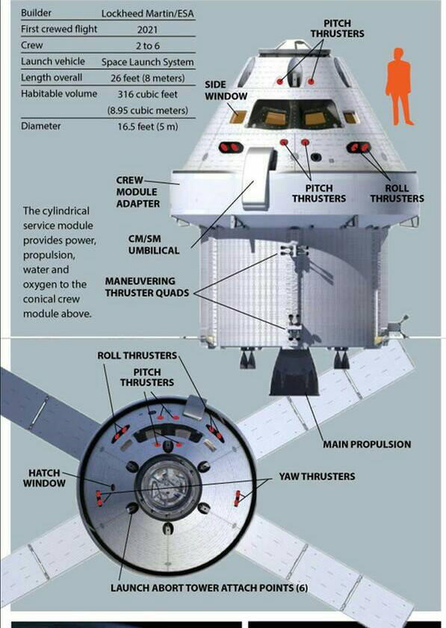

Slide 9
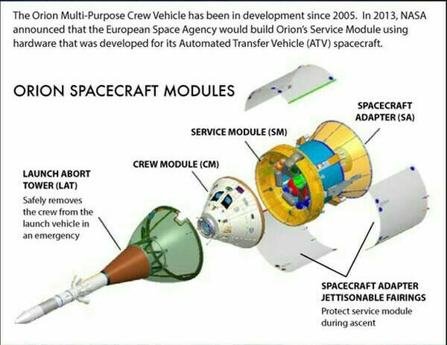
Orion’s crew module is just one of five components of the spacecraft . Orion also contains a launch abort system to pull astronauts away from the spacecraft with escape rockets should something go wrong during launch.

Slide 10
First test flight and beyond
Orion’s first uncrewed flight test, known as exploration flight test -1, or EFT-1,launched on dec 5,2014. this test flight marked the first time a spacecraft built for humans has flown outside low earth orbit in more than 40 years, since the last mission of the Apollo program in 1972.
The space capsule seemed to perform nearly during its 4.5 hour test flight , NASA officials said .Orion soared 3600 miles(5800 kilometers) above earth before turning around for a high- speed re -entry. the parachutes and huge heat shield on Orion seemed to work well during flight.

Slide 11
The spacecraft beamed back some amazing images of the limb of the planet from its window during the test before it splashed down in pacific ocean.U.S .navy officials have now fished Orion out of the ocean, and the craft is being transported back to Florida where scientists will collect the data it recorded during its flight.
This test flight did not include the SLS ,but instead used the united launch alliance delta 4 heavy rocket for a boost into orbit. another test flight with Orion and SLS together will take place in 2017 or 2018.crewed missions according to the current NASA schedule, will take place in 2021.

Slide 12
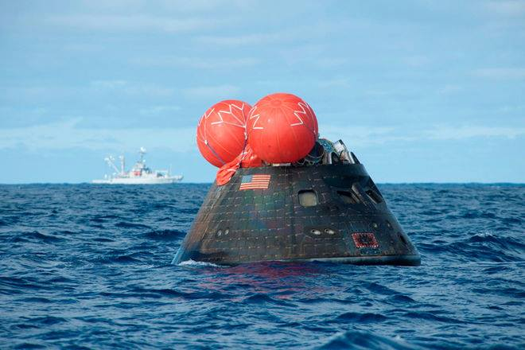
NASA’s Orion spacecraft splashed down in the pacific ocean following its first uncrewed test flight on dec 5,2014.

Slide 13
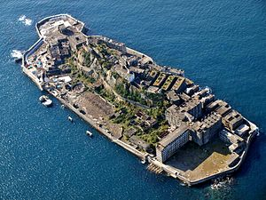
conclusion
There are many advantages of spacecrafts, and many unknown places can be found using satellites.
For example., an island near Nagasaki..by name hashima island. It is one of the 505 uninhabited island in Nagasaki. The islands most notable features are its abandoned concrete buildings, undisturbed except by nature and surrounded by sea walls.

Slide 14
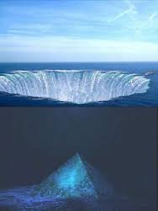
One more important discovery by the spacecraft is gaint triangle that was found in Australia.

